Slide 1




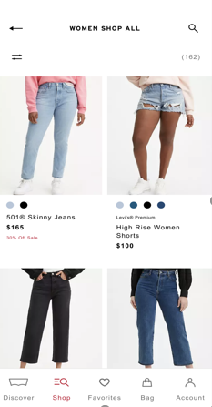
Modernizing front-end of an eCommerce implementation
Next-gen Multi-brand, multi-locale & multilingual website implemented by transitioning to a microservices based architecture.
The business challenge
Levi’s was struggling with the performance of their eCommerce application (SAP Hybris) due to a monolithic architecture.
Solution
Revamped the front-end using React, Vue.js and microservices.
The solution can now invoke GraphQL endpoints instead of serving entire pages from the server
Website was optimized on performance, the algorithms were rewritten, caching logic and content delivery was redesigned
Infrastructure scaling depending upon the usage. E.g., usage of machines for various transactions was tuned depending upon the request (like shopping v/s payment)
Easier code maintenance by code optimization and micro code improvements
Xebia’s XAssure Test Automation platform was setup to automate testing
Benefit
Increased online bookings by 50% by end of 2020 after release in Apr
Real-time results in Microseconds compared to couple of seconds earlier
Ability to handle peak volumes with less resources, giving cost benefits

